Slide 1

Computer Vision
Presented by:

Slide 2
Contents
Introduction
Computer vision vs human
Computer vision system methods
Recognition Cues
Mathematics in computer vision
Computer vision applications
Some Models Computer Vision

Slide 3
What is computer vision?
Computer vision is about getting, processing, and understanding images to build systems that can learn from visual data.
It copies how humans see and understand images, using data from videos, depth images, multiple cameras, medical scans, and satellites.
Notes:
Computer vision is a field that includes methods for acquiring, processing, analyzing, and understanding images
Known as Image analysis, Scene Analysis, Image Understanding duplicate the abilities of human vision by electronically perceiving and understanding an image
Theory for building artificial systems that obtain information from images.
Image data can take many forms, such as a video sequence, depth images, views from multiple cameras, medical scanner, satellite sensors etc.

Slide 4
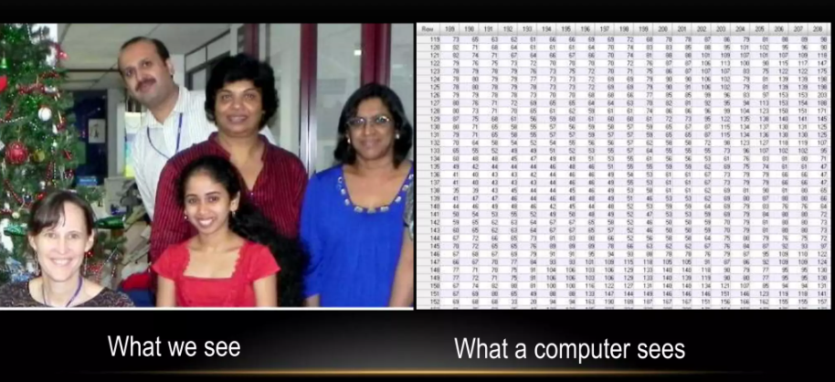
Computer Vision Vs Human Vision

Slide 5
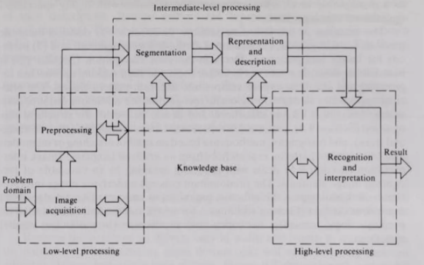
Computer Vision System Methods
Image acquisition
Pre-processing
Feature extraction
Detection/segmentation
Recognition an interpretation

Slide 6
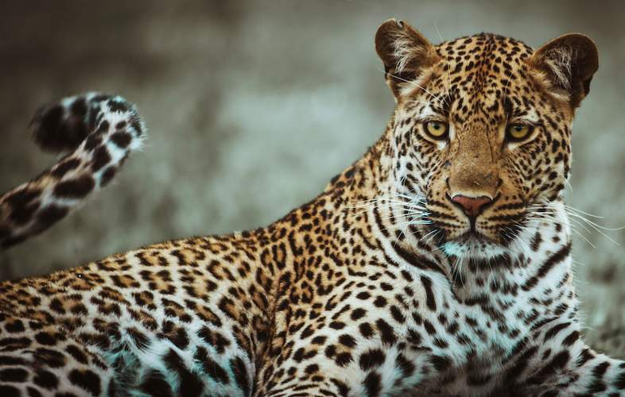

Recognition Cues
Cues
Texture
Pattern
Shape
Association

Slide 7
MATHEMATICS IN COMPUTER VISION
Calculus
Linear Algebra
Probabilities and Statistics
Signal Processing
Projective Geometry
Computational Geometry
Optimization Theory
Control Theory

Slide 8
COMPUTER VISION APPLICATIONS
Controlling processes
Navigation
Detecting events
Organizing information
Modeling objects or environments
Interaction
Automatic inspection, e.g. in manufacturing applications
much more ......
Notes:
1. Controlling processes: Automating and monitoring industrial processes using visual feedback.
2. Navigation: Guiding autonomous vehicles and robots by interpreting visual data.
3. Detecting events: Identifying and responding to specific occurrences in video feeds, like security breaches.
4. Organizing information: Sorting and categorizing visual data, such as in image and video databases.
5. Modeling objects or environments: Creating 3D models of physical spaces and objects from images or videos.
6. Interaction: Enhancing human-computer interaction through gestures, facial recognition, and eye tracking.
7. Automatic inspection: Checking products for defects in manufacturing using automated visual inspection systems.
8. Much more: Extending to various fields like healthcare, agriculture, and entertainment with diverse applications.

Slide 9
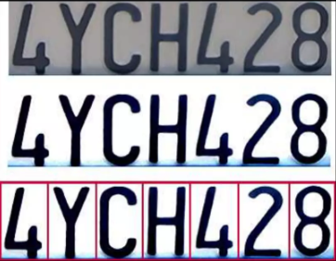
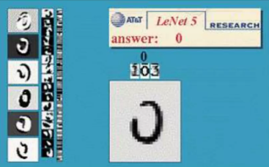
Optical Character Recognition(OCR)
Notes:
Optical Character Recognition (OCR) is a technology that converts different types of documents, such as scanned paper documents, PDFs, or images captured by a digital camera, into editable and searchable data.

Slide 10
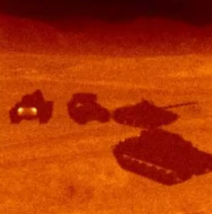
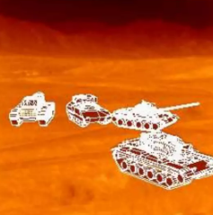
Target Recognition

Slide 11
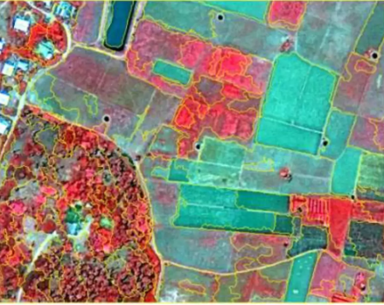
Interpretation of High-Resolution Satellite Images
Notes:
High-resolution satellite image interpretation involves analyzing detailed images of the Earth's surface to identify and classify different land uses and features, such as vegetation, water bodies, and urban areas. This process supports applications in urban planning, agriculture, environmental management, and disaster response.

Slide 12
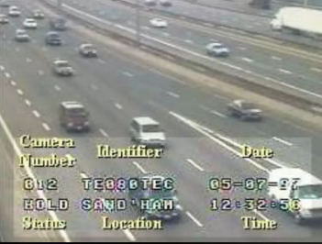
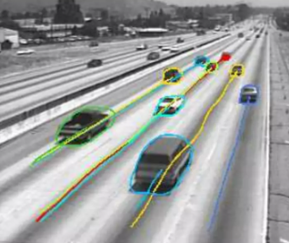
Traffic Monitoring
Notes:
Traffic monitoring in computer vision uses cameras and algorithms to analyze real-time video footage, detecting and tracking vehicles to manage traffic flow, identify congestion, and enhance road safety. This technology helps in optimizing traffic signals, reducing accidents, and improving urban mobility.

Slide 13
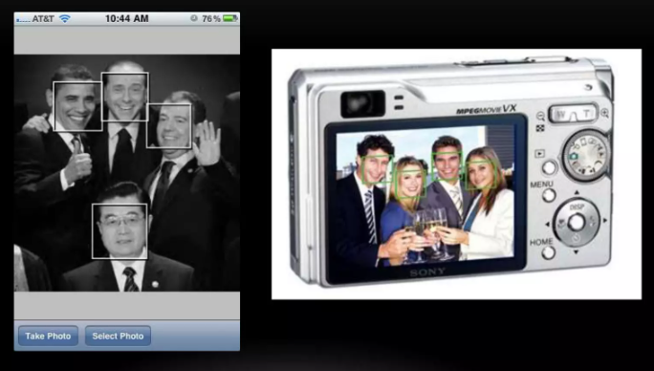
Face Detection
Notes:
Face recognition in computer vision involves detecting, extracting features, and comparing facial patterns to identify or verify individuals, crucial for applications like security and authentication.

Slide 14
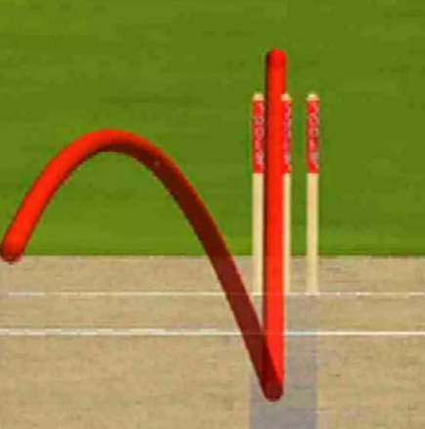
Sports

Slide 15
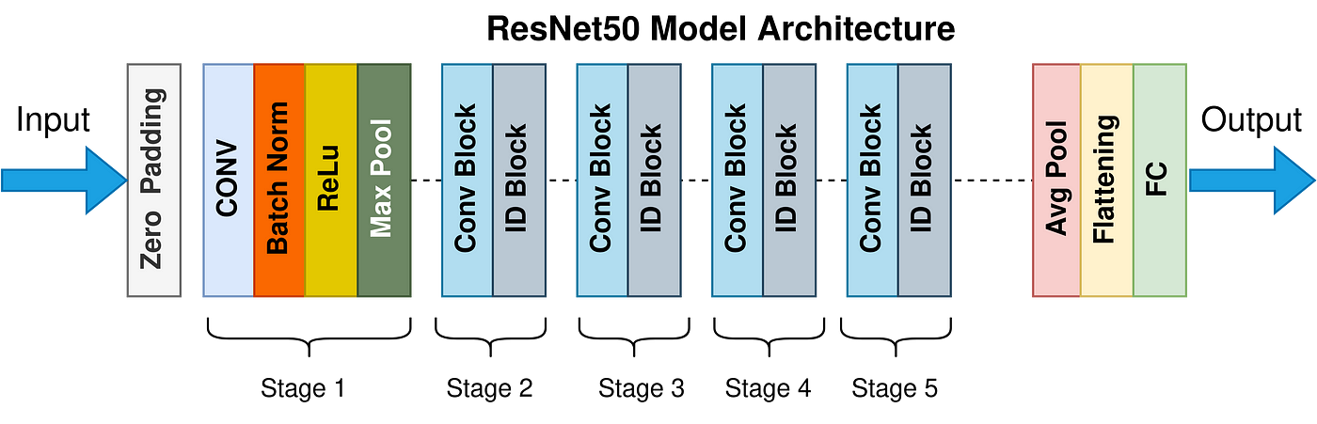
Some Models Computer Vision
Image Classification
ResNet (Residual Networks)
VGGNet
Object Detection
YOLO (You Only Look Once)
Faster R-CNN
Image Segmentation
U-Net
DeepLab
Notes:
Image Classification
- ResNet (Residual Networks): Pre-trained ResNet models can be fine-tuned for specific image classification tasks, such as identifying different types of animals or detecting specific objects in images.
- VGGNet: This model can be adapted to classify images into various categories by fine-tuning it on a smaller, domain-specific dataset.
Object Detection
- YOLO (You Only Look Once): YOLO is a pre-trained model used for real-time object detection. It can be fine-tuned to detect specific objects in various environments.
- Faster R-CNN: This model can be adapted for detecting and localizing objects in images, which is useful in applications like autonomous driving and surveillance.
Image Segmentation
- U-Net: A pre-trained U-Net model can be fine-tuned for tasks like medical image segmentation, where it is used to delineate boundaries of organs or tumors in medical scans.
- DeepLab: This model can be adapted for semantic segmentation, where each pixel in an image is classified into a category, useful in applications like scene understanding and autonomous driving.

Slide 16
Conclusion
Computer vision enables machines to understand and interpret visual information, essential for tasks like image recognition and object detection.
Notes:
Computer vision helps computers see and understand images. It's used for things like recognizing objects in photos and videos. This technology is important in many areas, from security cameras to medical scans, because it helps computers interpret what they see, just like humans do.

